Slide 1
Curriculum for Life Session 4

Slide 2
Curriculum for Life Session 4
Session 4 Different types of debt, Annual Percentage Rate (APR)
Session 1 What is debt? Money management – true or false?
Session 2 Video – hear from other 16-25 year olds, Managing your money
Session 3 Why your credit score is so important
Session 5 Key tips on managing debt, Help and support available
Notes:
Explain what the money management module is expected to help with.
Highlight that this is one lesson out of five and briefly what the other lessons include.

Slide 3
Borrow from friends
Mortgage
Cash Converters
Payday Loan
Loan Sharks
Credit Card
Credit Unions
Pawn Brokers
Contracts
Overdraft
Hire Purchase
Loans
Think about the different types of borrowing an how to avoid debt
Notes:
Split the participants into groups.
Ask each group to write down all of the types of debt that they can think of onto one piece of paper.
Once they have done this, ask the groups to share a few examples. Then show the examples provided on the next slide
---------------------------------------
Explain what each type of debt means and how it works (background research is required by the trainer to fully understand each one and be able to explain to the group)
Desired Outcome 1. Provide a simple way to learn and understand the many different types of debt.

Slide 4
Definition APR is the amount of interest you'll pay over a year on money you have borrowed.
Notes:
To gauge whether anyone knows about APR – ask the participants to raise their hand if they have heard about it or knows what it is.
Show the definition of APR and explain what this means.

Slide 5
1
2
The interest APR rate
The length of time the loan is paid back
Notes:
Explain that there are two key points that feed in to APR:
Interest rate – this is given as a percentage and affects how much extra money you have to pay to borrow money.
Length of time – the longer you borrow for, the more interest (and therefore money) you will end up paying back.
Once you have explained what APR is and the things to consider, ask the participants to work in their teams to make a calculation.

Slide 6
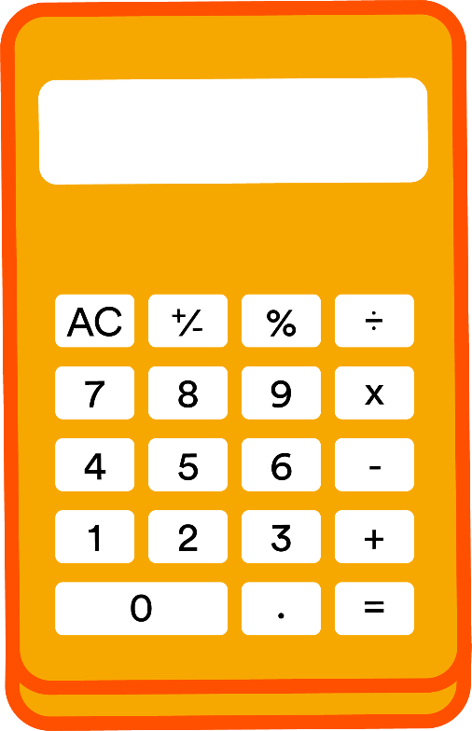
Emma wants a loan for a new fridge.
Using the information below, calculate how much Emma will have to pay back…
Curriculum for Life Module - Session 2 (PDF 1.31 MB opens in a new window)
Curriculum for Life Module - Session 2 (PDF 1.31 MB opens in a new window)
(This is an extra £50)
Loan amount is £200
APR (Interest Rate) is 25%
The money is borrowed for 12 months
Notes:
Read through the example of someone needing to borrow money for a fridge.
Explain the example and ask each participant to work out how much they will have to pay back in total.
Stress the point that they have had to pay an extra £50 for this.

Slide 7
Emma wants a loan for a new fridge.
Using the information below, calculate how much Emma will have to pay back…
Curriculum for Life Module - Session 2 (PDF 1.31 MB opens in a new window)
Curriculum for Life Module - Session 2 (PDF 1.31 MB opens in a new window)
(This is an extra £50)
Loan amount is £200
APR (Interest Rate) is 25%
The money is borrowed for 12 months
Notes:
Read through the example of someone needing to borrow money for a fridge.
Explain the example and ask each participant to work out how much they will have to pay back in total.
Stress the point that they have had to pay an extra £50 for this.

Slide 8
APR = 311.3%
APR = 29.4%
12 month loan
12 month loan
Borrow £1000
Borrow £1000
Total to be paid back £4,113
Total to be paid back £1,294
Interest paid £3,113
Interest paid £294
Notes:
Explain that you will now give two examples of different interest rates and the impact that this will have.
This slide is to emphasise the alternatives to personal loan companies such as banks which are more likely to provide more favourable interest rates. Stress how much higher the repayment will be if you decide to get a loan from a company asking much higher rates.

Slide 9
Pay Day Loan - APR = 2000%
Tyler has just received an unexpected bill which means he now won’t have enough money to cover his outgoings for the rest of the month.
He decides to get a loan from a pay day loan company, borrowing £300 for one month.
Total repayment: £386.64
Tyler decides not to pay back the loan and leave it for another month. The pay day loan company he borrowed the original £300 from will now charge Tyler extra fees and interest for the late repayment.
Total repayment after two months: £498
If Tyler continues to ignore his repayments, after 12 months the total interest on the original £300 loan would be £6,000!
Notes:
Run through the example of an individual taking out a loan from a pay day loan company – not only are the interest rates incredibly high but also failure to pay this back in the agreed time will result in higher interest rates and also late fees.

Slide 10
Credit Card Repayment
A small change to the amount you are paying back a month can dramatically reduce the time it will take to pay off your balance and the amount of interest you will have to pay.
Option 1
1
Option 2
2
Balance of £2500
Only paying the minimum payment of £63 per month
Time until paid off – 26 years & 2 months
Balance of £2500
Increase repayment by just £1 per day up to £93 per month
Time until paid off – 2 years & 11 months PLUS paying £2,874 less in interest
Notes:
Run through the examples to reinforce how much impact slightly increasing the amount you are paying back will have on a credit card debt.
Stress the point that paying only slightly more will really make a difference and save a significant amount of money overall.

Slide 11
Citizens Advice
https://www.citizensadvice.org.uk/
Money Advice Service
https://www.moneyadviceservice.org.uk/en
Money Saving Expert
https://www.moneysavingexpert.com/
Notes:
Explain that there are a number of organisations that provide help and support if people need advice.

Slide 12
We’re here when you need us
Don’t ignore the problem
Talk to companies that you owe money to
Priority Services – for you or a family member
For information about the help and support available at United Utilities, please see our website: https://www.unitedutilities.com/
Notes:
The important thing to remember if you’re finding it hard to pay your bills is - don’t ignore the problem. Debts very rarely disappear all by themselves!
If you’re ever struggling to pay your water bill, the good news is that we have lots of ways we can help. This could include delaying your payments, reducing your bill or setting up a payment plan which makes your bill easier to pay. Paying your water bill by Direct Debit will also reduce your bill by £5 a year.
Remember, most companies you deal with will help if you’re struggling with your bills so always give them a call as soon as you have a problem. Companies have nothing to gain by you falling behind with your payments and will always try to help.
If you or a family member need additional support due to disability, mental health issues, debt or age, please let us know. We can then register you for our Priority Services scheme which means you benefit from additional free services related to your water and wastewater services. Your energy company will also have a priority services scheme you can register for.

Slide 13
Notes:
Briefly discuss what has been run through in the session and answer any questions with the group to ensure they have understood the content.
Ask each of the participants for one thing that they have learnt today.

