Slide 1




Curriculum for Life Session 1

Slide 2


Curriculum for Life Session 1
Session 1
What is debt?
Money management – true or false?
Session 2
Video – hear from other 16-25
year olds, Managing your money
Session 3
Why your credit score is so important
Session 4
Different types of debt,
Annual Percentage Rate (APR)
Session 5
Key tips on managing debt,
Help and support available
Notes:
Explain what the money management module is expected to help with.
Highlight that this is one lesson out of five and briefly what the other lessons include.

Slide 3


An amount of money that you owe to a person, bank, company, etc.
Notes:
Ask the group to work in teams to come up with a one sentence definition of what they think debt is.
Ask each team to share their sentence before showing the definition.
Discuss what the group think of the definition and what it means.

Slide 4






It’s okay to spend more money than I earn
You’ll soon run out of money and fall into debt! Always keep an eye on your money when you’re splashing the cash.
Notes:
Read out each sentence – ask the participants to stand up if they think a sentence is true, or remain seated if they think it is false.
Tell the participants the right answer at the end of each sentence and explain the reason – discuss with the group if they have questions.

Slide 5
It’s okay to spend more money than I earn
You’ll soon run out of money and fall into debt! Always keep an eye on your money when you’re splashing the cash.
Notes:
Read out each sentence – ask the participants to stand up if they think a sentence is true, or remain seated if they think it is false.
Tell the participants the right answer at the end of each sentence and explain the reason – discuss with the group if they have questions.

Slide 6





A good credit
score is important
Your credit score is used by companies when deciding whether to loan you money or let you buy new stuff on monthly instalments.
Notes:
Read out each sentence – ask the participants to stand up if they think a sentence is true, or remain seated if they think it is false.
Tell the participants the right answer at the end of each sentence and explain the reason – discuss with the group if they have questions.

Slide 7
A good credit
score is important
Your credit score is used by companies when deciding whether to loan you money or let you buy new stuff on monthly instalments.
Notes:
Read out each sentence – ask the participants to stand up if they think a sentence is true, or remain seated if they think it is false.
Tell the participants the right answer at the end of each sentence and explain the reason – discuss with the group if they have questions.

Slide 8



You can only borrow money from pay day loan providers
There are a number of other places to borrow money. You’ll pay less interest on money you loan from a bank.
Notes:
Read out each sentence – ask the participants to stand up if they think a sentence is true, or remain seated if they think it is false.
Tell the participants the right answer at the end of each sentence and explain the reason – discuss with the group if they have questions.

Slide 9
You can only borrow money from pay day loan providers
There are a number of other places to borrow money. You’ll pay less interest on money you loan from a bank.
Notes:
Read out each sentence – ask the participants to stand up if they think a sentence is true, or remain seated if they think it is false.
Tell the participants the right answer at the end of each sentence and explain the reason – discuss with the group if they have questions.

Slide 10
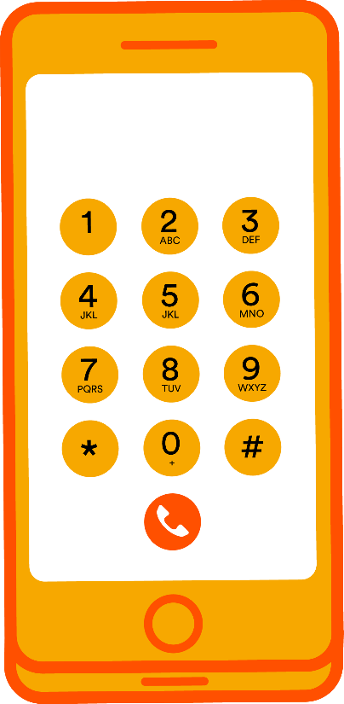

Your credit score will affect whether you can get a mobile phone contract
Mobile phone companies check your credit score before deciding whether to give you a shiny
new phone.
Notes:
Read out each sentence – ask the participants to stand up if they think a sentence is true, or remain seated if they think it is false.
Tell the participants the right answer at the end of each sentence and explain the reason – discuss with the group if they have questions.

Slide 11
Your credit score will affect whether you can get a mobile phone contract
Mobile phone companies check your credit score before deciding whether to give you a shiny
new phone.
Notes:
Read out each sentence – ask the participants to stand up if they think a sentence is true, or remain seated if they think it is false.
Tell the participants the right answer at the end of each sentence and explain the reason – discuss with the group if they have questions.

Slide 12


It is okay to treat yourself every now and again if you can afford to do so
If you budget properly and save up, you can still buy yourself nice things without having to
borrow money.
Notes:
Read out each sentence – ask the participants to stand up if they think a sentence is true, or remain seated if they think it is false.
Tell the participants the right answer at the end of each sentence and explain the reason – discuss with the group if they have questions.

Slide 13
It is okay to treat yourself every now and again if you can afford to do so
If you budget properly and save up, you can still buy yourself nice things without having to
borrow money.
Notes:
Read out each sentence – ask the participants to stand up if they think a sentence is true, or remain seated if they think it is false.
Tell the participants the right answer at the end of each sentence and explain the reason – discuss with the group if they have questions.

Slide 14





Citizens Advice
https://www.citizensadvice.org.uk/
Money Advice Service
https://www.moneyadviceservice.org.uk/en
Money Saving Expert
https://www.moneysavingexpert.com/
Notes:
Explain that there are a number of organisations that provide help and support if people need advice.

Slide 15


We’re here when you need us
Don’t ignore the problem
Talk to companies that you owe money to
Priority Services – for you or a family member
For information about the help and support available at United Utilities, please see our website: https://www.unitedutilities.com/
Notes:
The important thing to remember if you’re finding it hard to pay your bills is - don’t ignore the problem. Debts very rarely disappear all by themselves! And if you don’t pay your bills, this will give you a bad credit score which makes it much harder to apply for a loan or get a new mobile phone contract
If you’re ever struggling to pay your water bill, the good news is that United Utilities have lots of ways we can help. This could include delaying your payments, reducing your bill or setting up a payment plan which makes your bill easier to pay. Paying your water bill by Direct Debit will also reduce your bill by £5 a year.
Remember, most companies you deal with will help if you’re struggling with your bills so always give them a call as soon as you have a problem. Companies have nothing to gain by you falling behind with your payments and will always try to help.
If you or a family member need additional support due to disability, mental health issues, debt or age, please let us know. We can then register you for our Priority Services scheme which means you benefit from additional free services related to your water and wastewater services. Your energy company will also have a priority services scheme you can register for.

Slide 16


Notes:
Briefly discuss what has been run through in the session and answer any questions with the group to ensure they have understood the content.
Ask each of the participants for one thing that they have learnt today.

